Slide 1


HỌC VIỆN CÔNG NGHỆ BƯU CHÍNH VIỄN THÔNG
COMPUTER ARCHITECTURE
Interface programming
Instructor: Associate Professor Phạm Văn Cường
E-mail: cuongpham.ptit@gmail.com
www: https://sites.google.com/view/cuongpham/home

Slide 2
CONTENT
CPU spin signals
CPU-memory interfacing
I/O Interface programming

Slide 3
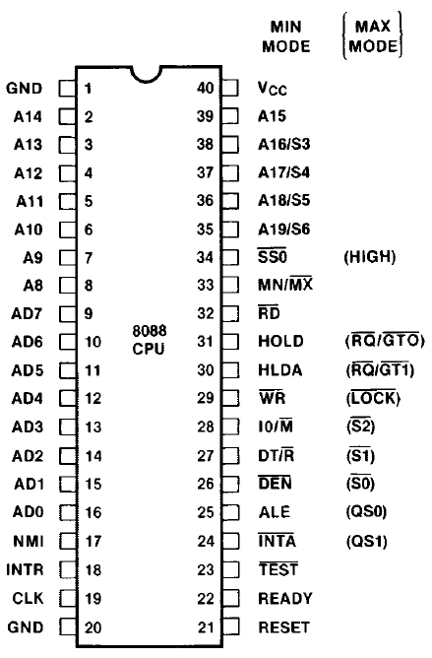
8088 spin signals
8088 has 40 spin signals:
Address:
AD₀-AD₇: shared with bus D;
A₈-A_{15;} A₁₆/S₃-A₁₉/S₆;
Data:
AD₀-AD₇: shared with bus A và bus D;
ALE=0→data, ALE=1→address.
Control:
others

Slide 4
Memory decoding using logical circuits
Memory ROM 2K×8
Address range: FF800−FFFFF
Bits used for addressing cells within the chip ROM 2K: 11bit (A₀-A₁₀).
Bits for chip select
A₁₉…A₁₆A₁₅A₁₂A₁₁
1111 1111 1000 0000 0000 − 1111 1111 1111 1111 1111
CS = RD OR NOT((A₁₉…A₁₆A₁₅A₁₂A₁₁)AND(IO/M))
NOT AND

Slide 5
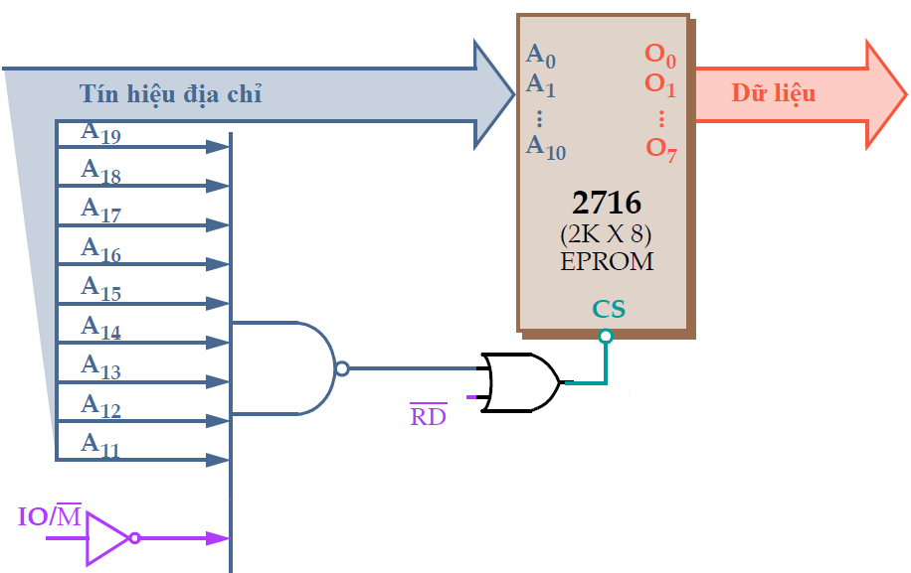
Memory decoding using logic circuits
Notes:
D08.1 6.9

Slide 6
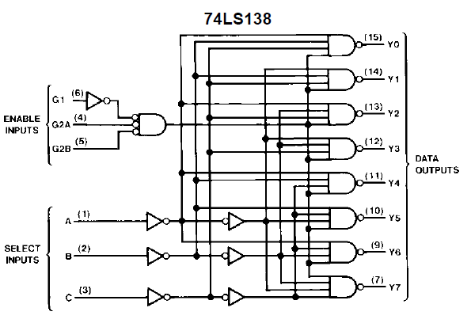
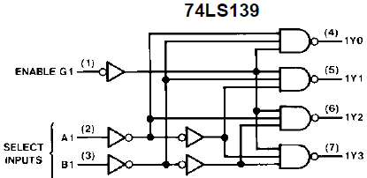
Memory decoding using 74LS138

Slide 7
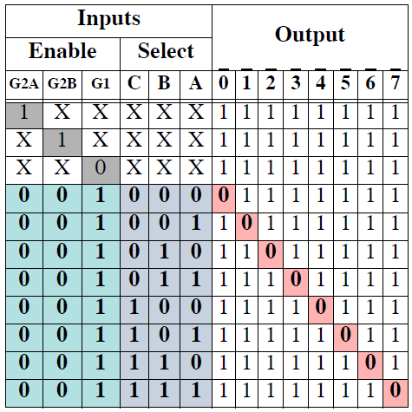
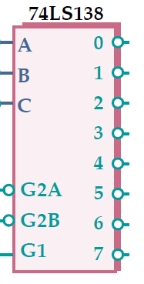
Memory decoding using 74LS138
74LS138

Slide 8
Memory decoding using 74LS138
Memory EPROM 4K×8
Address range: F8000−FFFFF (32KB)
Address signals used for addressing cells in chip EPROM 4K: 12bit (A₀-A₁₁).
Address signals used for chip select : A₁₉…A₁₆A₁₅…..A₁₂
A₁₂A₁₃A₁₄ can be changed while A₁₅-A₁₉ are unchanged (=1).
➔ Connect A₁₂A₁₃A₁₄ to A, B, C respectively; A₁₅-A₁₉ and IO/M connected to (G2A, G2B).

Slide 9
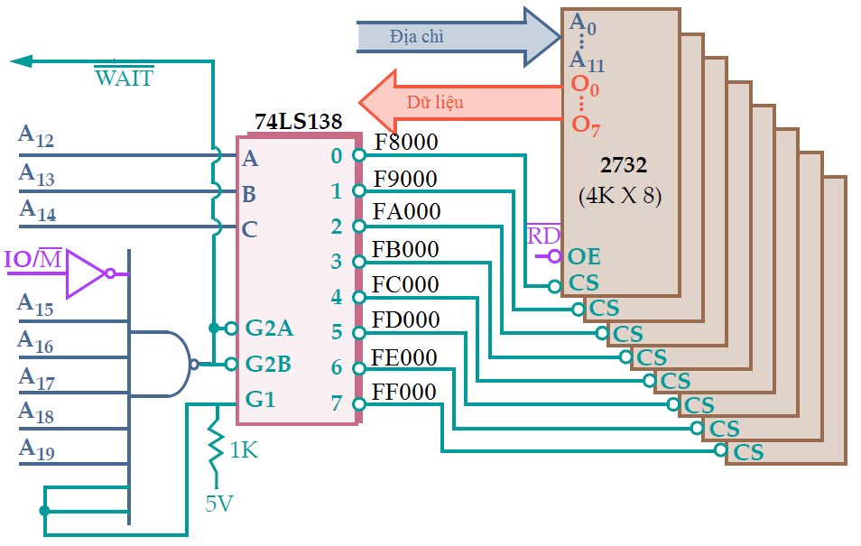
Memory decoding using 74LS138

Slide 10
CPU-I/O interfacing
CPU
I/O
Data
Input ports
Buffer reg.
Address
Status reg.
Output ports
I/O protocol
Control
I/O controller
Notes:
D08.3 5.9

Slide 11
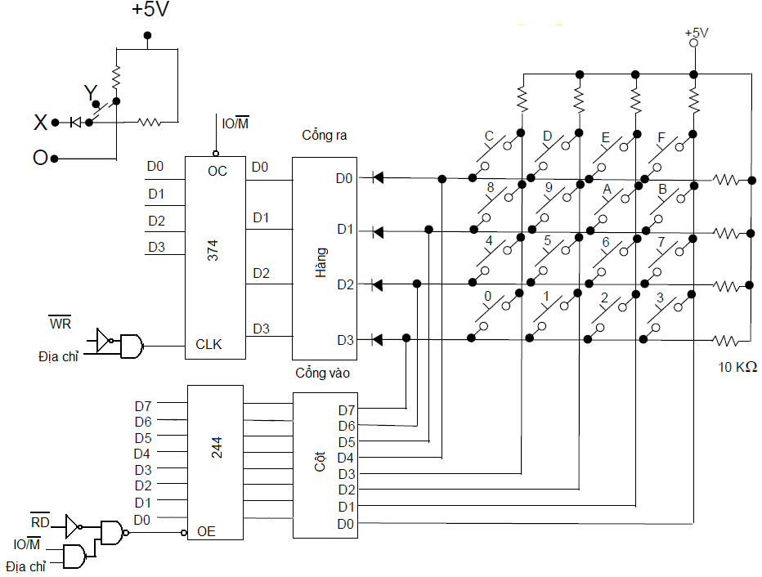
Keyboard-CPU

Slide 12
Keyboard-CPU
16 keys:
74LS374 for row and 74LS244 for column;
How to determine of a key is pressed: scan rows and read columns. If a key is pressed than D_{i} = 0.

Slide 13
Example code
Code to check if key C (row D0, column D3) is pressed. Port address for row is 0Ah and port for column is 0Bh.
Hang EQU 0AH ; row port address
Cot EQU 0BH ; column port address
MOV AL,11111110b ; D0=0 – scan row 0
OUT Hang, AL
Ktra: IN AL, Cot ; read the column port
AND AL,00001000b ; check D3 ( key C)
JNZ Ktra ; not pressed yet
... ; pressed

Slide 14
LED interface
7447 and LED interfacing:
Port A: address 0AH, receives the control signals (ON/OFF).
Port B: address 0BH, receives the number to be displayed on LED in BCD format.
Turn LED i ON : send D_{i} = 0 to port A
Turn LED i OFF: send D_{i} = 1 to port A
Display the number n: send n to port B, then turn LED i ON.

Slide 15
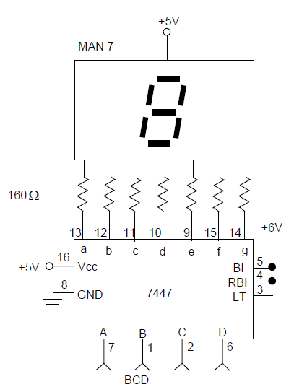
LED

Slide 16
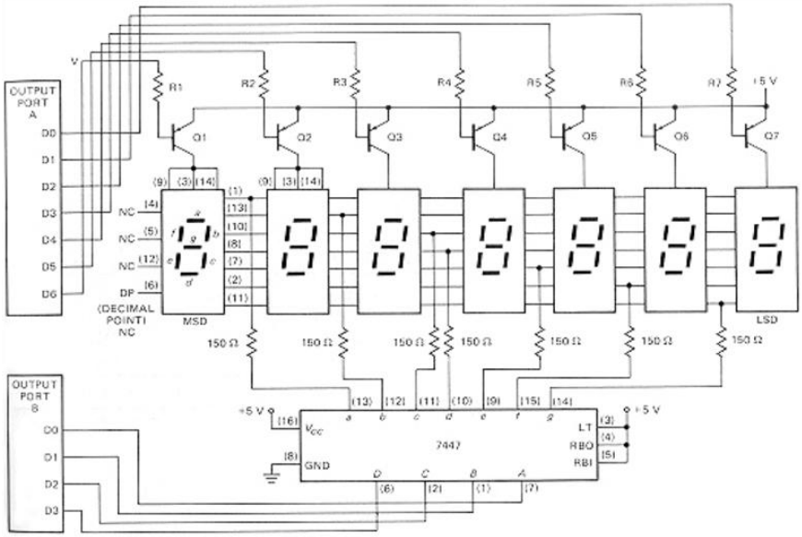
LED interfacing

Slide 17
Example code
Code to display 8 on all 7 LEDs. Control port is 0Ah and data port is 0Bh.
DK_LED EQU 0AH ; Cổng điều khiển LED
DL_LED EQU 0BH ; Cổng dữ liệu hiển thị
MOV AL,FFH ; Tắt tất cả các LED
OUT DK_LED, AL
MOV CX,64 ; Trễ bằng 64 lệnh NOP
Tre: NOP
LOOP Tre
MOV AL,8 ; Đưa số 8 ra 7447
OUT DL_LED,AL
XOR AL,AL ; Đặt AL=0
OUT DK_LED,AL ; Bật tất cả các LED

